Slide 1
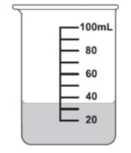

-PROBABILITY- Interactive Notebook
Name
Class
Teacher
Term 2 Semester 1
1

Slide 2
Contents
Glossary or Formula Page
Page
Date
Description
2
3

Slide 3
Tasks
24
7
30
Essential Question
Questions
Notes
Summary
4
5

Slide 4
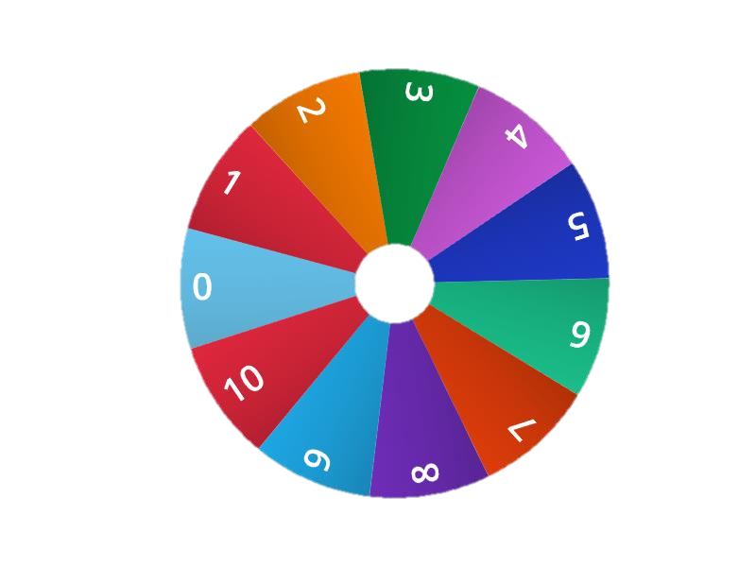
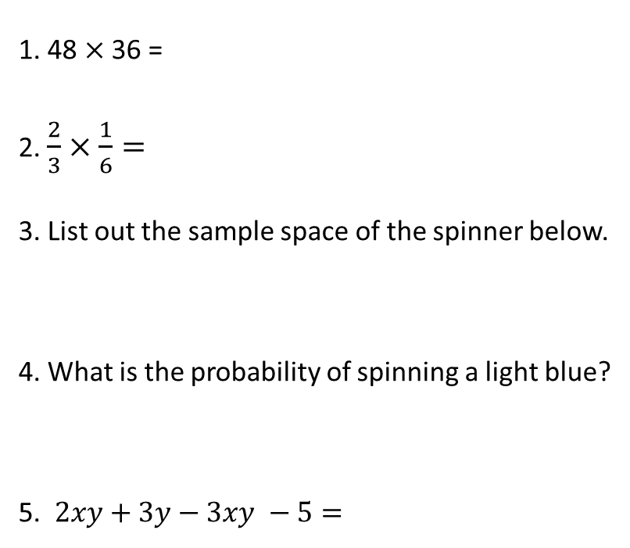
24
7
30 Venn Diagrams
EQ – What does a Venn diagram look like?
1. 48 $×$ 36 =
2. $\frac{2}{3}×\frac{1}{6}=$
3. List out the sample space of the spinner below.
4. What is the probability of spinning a light blue?
5. $2xy+3y−3xy −5=$

Slide 5
24
7
30 Venn Diagrams
Date
EQ – What does a Venn diagram look like?
A Venn diagram is
a pictorial representation of
a two-way table without
the total row and total column.
A two way table can be written as a Venn diagram as
5

Slide 6
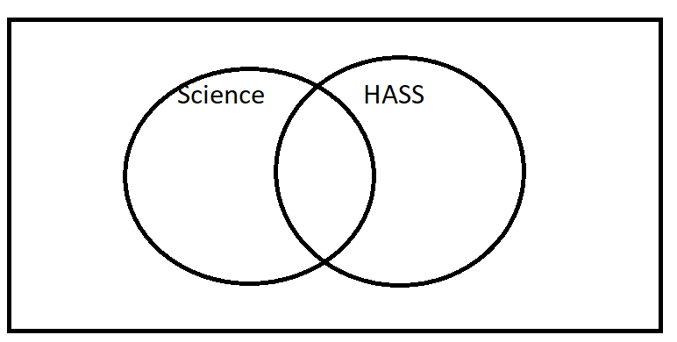
2way to Venn (copy into your notes)
 | Like Science | Do not like Science | Total
Like HASS | 28 | 33 | 61
Do not like HASS | 5 | 34 | 39
Total | 33 | 67 | 100
Notes:
Fill in the Venn diagram with the class explaining where each of the numbers go

Slide 7
What does the overlap represent?
Those who enjoy both. 28
What does the outside area mean?
Those who enjoy Neither. 34
There are only 4 numbers needed in a 2-circle Venn diagram = 4 Probabilities

Slide 8
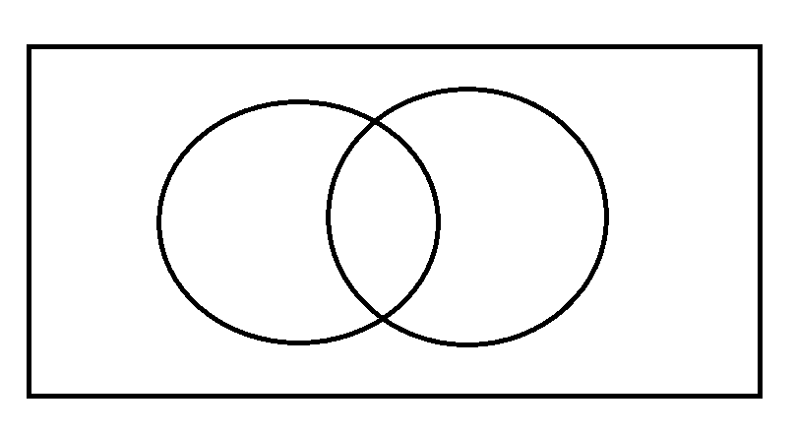
Draw the VENN diagram for…
In a class of 30 students there are 20 students who like Maths, 15 who like English and 12 who like both.

Slide 9
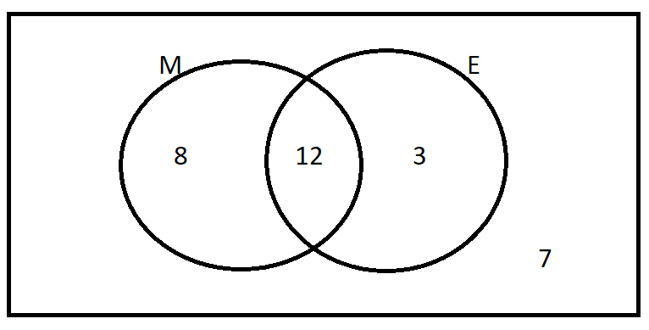
Answer

Slide 10
Create you own question to create your own Venn diagram

Slide 11
Use you VENN diagram
How many only like Math?
How many only like English?
How many don’t like either?

Slide 12
LHS
EASY Dwyer p.247 Ex, 18.2 Qns 1-3
MEDIUM. Dwyer p.252 Ex. 18.9 Qns 1-8
HARD. P. 500, q 12-13. Algebraic Venns & 2-way tables.
ENRICHMENT- Triple Venns…p. 501 Cambridge Essentials.

